Slide 1

THE EVOLUTION OF COVID-19 IN THE STATE OF NEW YORK A VISUAL TIMELINE
Group - 7
Bhoomi Parikh
L. Sameera Velama
Matiullah Mati
Ramya P. Jandhyala
Vikramaditya Devarakonda

Slide 2
PROJECT DESCRIPTION
Explore the Corelation between different covid-19 metrics in the state of new york
New york state health department
Hospitalizations, fatalities and vacinations
Statistical methods were used to analyse the data
5 Key hypothesis
Valuable insights on the impact of covid-19

Slide 3
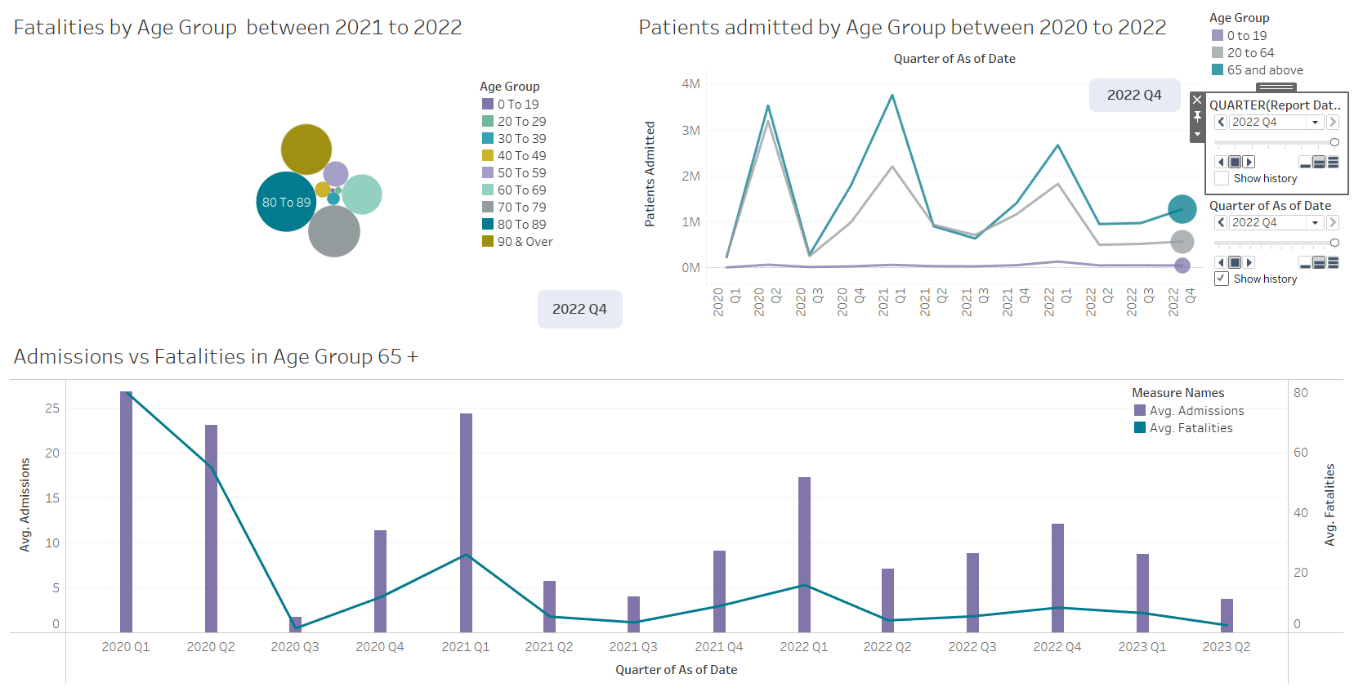
HYPOTHESIS 1
Covid patients aged 65+ are more likely to experience hospitalization and fatalities than patients in other age groups.
Conclusion: The visualizations indicate that COVID-19 patients aged 65 years and above experienced the highest rates of hospitalization and fatalities, providing empirical evidence to support the hypothesis.

Slide 4
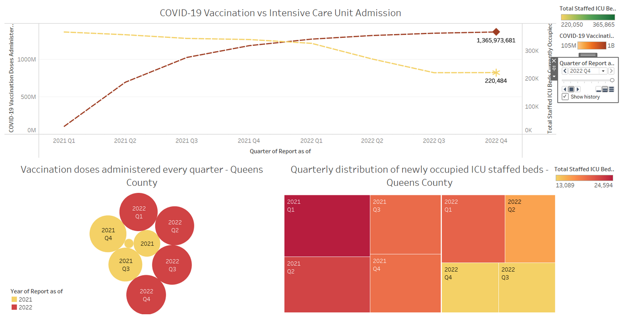
HYPOTHESIS 2
There is a correlation between the total number of COVID-19 vaccination doses administered and the number of newly occupied staffed ICU beds
Conclusion: The visualization indicates a correlation between the cumulative number of COVID-19 vaccination doses administered and the number of newly occupied staffed ICU beds in the Queens county. Specifically, areas with higher vaccination rates tend to have lower numbers of newly occupied ICU beds due to COVID-19

Slide 5
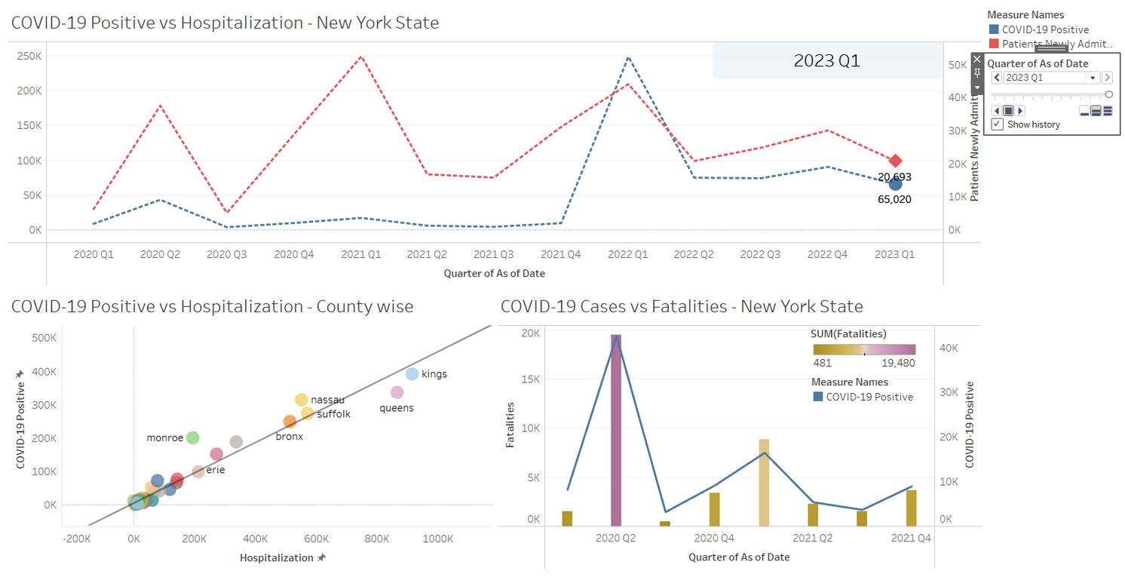
HYPOTHESIS 3
There is a positive correlation between the number of COVID-19 positive cases and the number of fatalities in a county in New York State.
Conclusion: There is indeed a positive correlation between the number of COVID-19 positive cases and the number of fatalities in a county in New York State. This implies that areas with a higher number of positive cases are more likely to experience a higher number of fatalities due to COVID-19

Slide 6
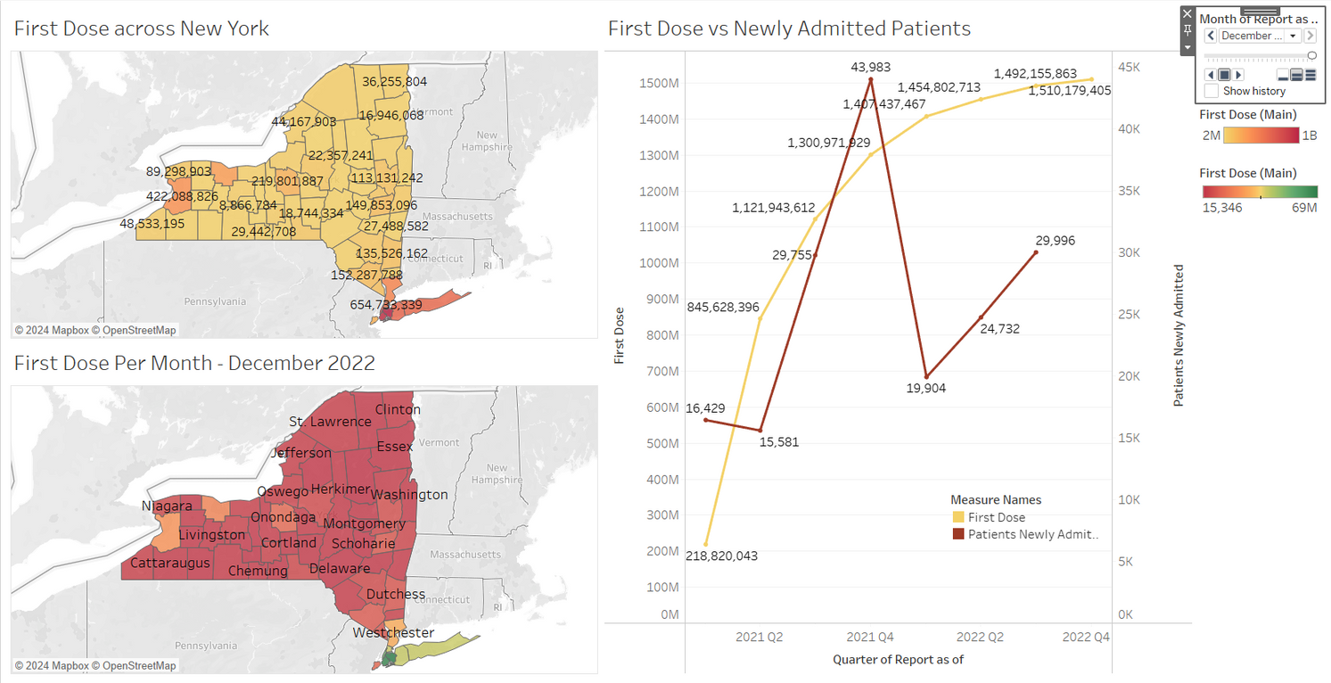
HYPOTHESIS 4
There exists a strong and significant correlation between the number of individuals who received their first dose of COVID-19 vaccination during a given quarter in a specific location and the number of newly admitted patients with COVID-19 in the subsequent quarter in the same location.
Conclusion: There is no strong and significant correlation between the number of individuals who received their first dose of COVID-19 vaccination in a specific location during a given quarter and the number of newly admitted COVID-19 patients in the same location during the subsequent quarter.

Slide 7
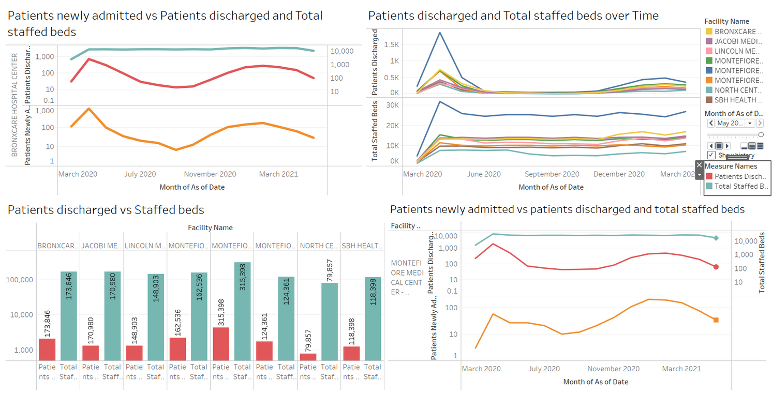
HYPOTHESIS 5
There is a significant relationship between the number of staffed acute care beds in a healthcare facility and the number of patient discharges.
Conclusion: There is a significant relationship between the number of staffed acute care beds in a healthcare facility and the number of patient discharges. The analysis suggests that facilities with more staffed beds can discharge more patients compared to those with fewer staffed beds, potentially due to their higher capacity to provide care.

Slide 8

THANK YOU

